Slide 1
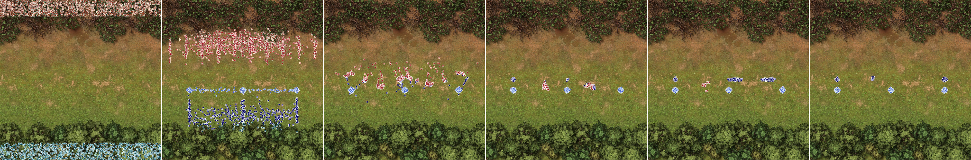
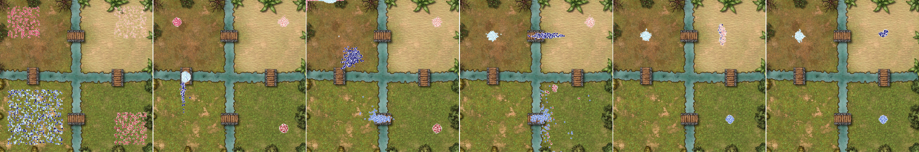
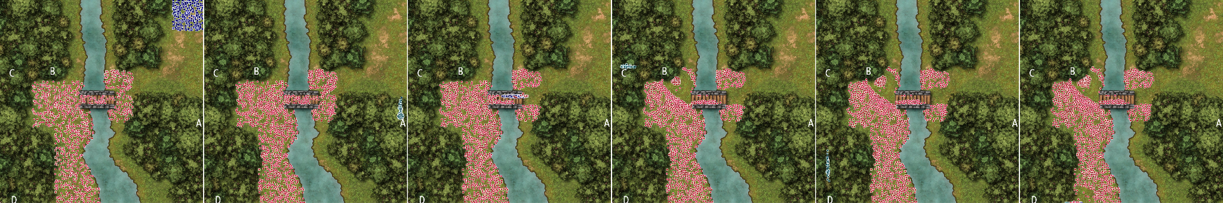
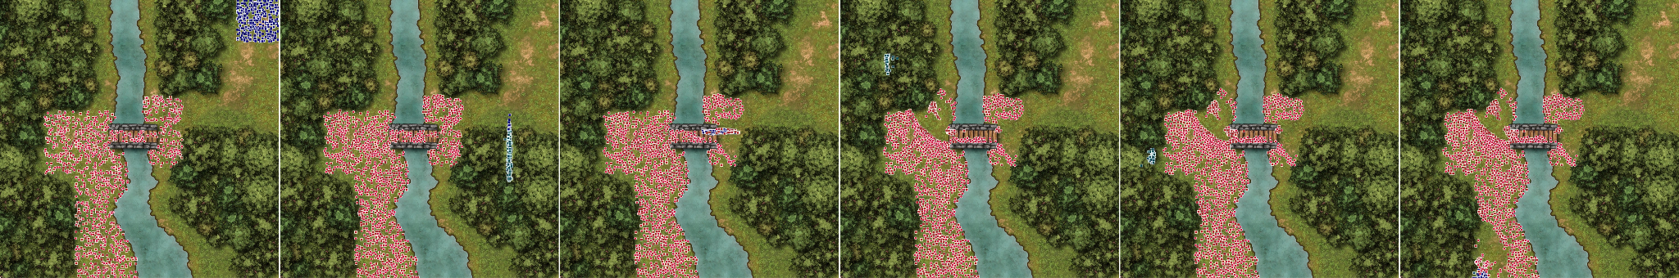
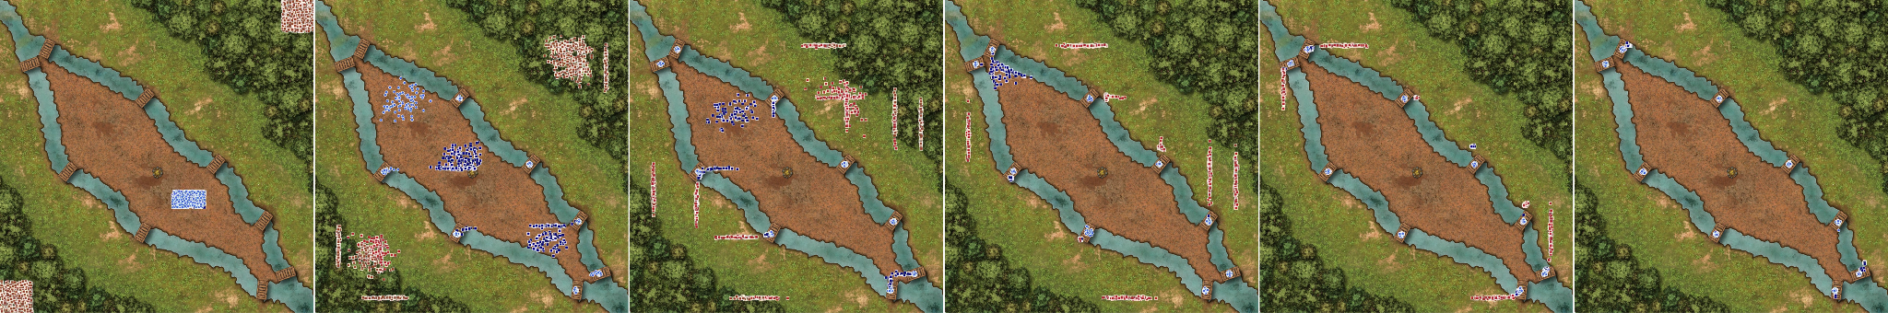
Coordinate with Sonnet: “Make a plan that forms as many squads as you think necessary to cover the middle row of the map to eliminate all the enemies as quickly as possible. Ensure to place our archers so that they protected by our close range units.”
Exploit weakness with Sonnet: “First, analyse the situation to compute the positions and types of the enemy squads. Then, write a plan that play on their weaknesses to split our army into three groups with specific strengths and send each one against one of the enemy squads to maximize efficiency.”
Follow markers with 4o-mini: “Move our troups to the markers A, B, C, D while ignoring enemies and then to the objective position.”
Exploit terrain with 4o: “Design a plan to move our spearmen inside the trees on the east close to the bridge, then make them run to the forest on the left, on top of the bridge to quickly regain cover. Then make them hide deep inside the forest on the left of the map. Finally, make them rush south to the south-east corner of the map inside the forest and then to the objective. Everything while ignoring enemies.”
Strategize points with o1-mini: “Split our army on all the bridges to guard them and make sure to send long-range and close-range units on each one.”

